Slide 1

Hadoop Echo System –
Elsayed Hemayed
Some of the slides are from CS525, WPI, Mohamed Eltabakh

Slide 2
Overview
What is HBase?
HBase Data Model
HBase Physical Model
HBase Architecture
Test Drive
Example

Slide 3
HBase: Overview
HBase is a distributed column-oriented data store built on top of HDFS
HBase is an Apache open source project whose goal is to provide storage for the Hadoop Distributed Computing
Data is logically organized into tables, rows and columns

Slide 4
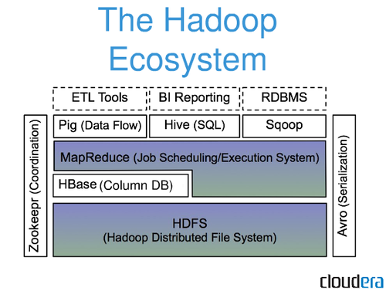
HBase: Part of Hadoop’s Ecosystem
HBase is built on top of HDFS
HBase files are internally stored in HDFS

Slide 5
HBase vs. HDFS
Both are distributed systems that scale to hundreds or thousands of nodes
HDFS is good for batch processing (scans over big files)
Not good for record lookup
Not good for incremental addition of small batches
Not good for updates

Slide 6
HBase vs. HDFS (Cont’d)
HBase is designed to efficiently address the above points
Fast record lookup
Support for record-level insertion
Support for updates
HBase updates are done by creating new versions of values

Slide 7
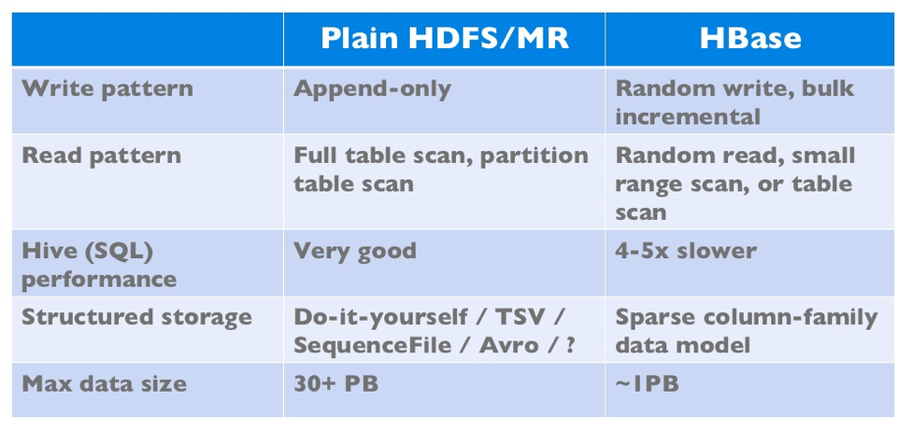
HBase vs. HDFS (Cont’d)
If application has neither random reads or writes ➔ Stick to HDFS

Slide 8
Who Uses HBase?
Adobe
Airbnb
Alibaba
Bloomberg
Flipkart
Huawei
HP
Hubspot
IBM
Microsoft
NetEase
Pinterest
Salesforce
Shopee
Tencent
Twitter
Xiaomi
Yahoo! (now Verizon Media)

Slide 9
HBase Data Model
HBase is based on Google’s Bigtable model
Key-Value pairs

Slide 10
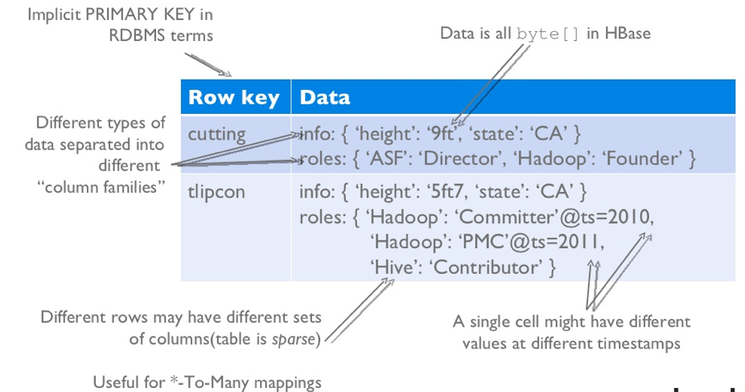
HBase Logical View

Slide 11
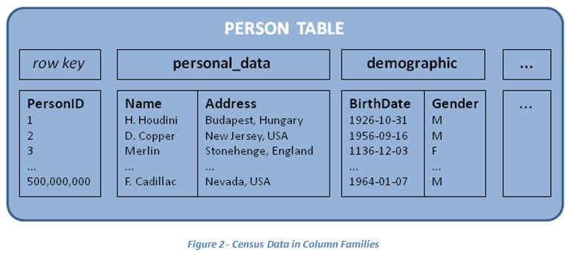
HBase: Keys and Column Families
Each record is divided into Column Families
Each row has a Key
Each column family consists of one or more Columns

Slide 12
Column family named “anchor”
Column family named “Contents”
Key
Byte array
Serves as the primary key for the table
Indexed for fast lookup
Column Family
Has a name (string)
Contains one or more related columns
Column
Belongs to one column family
Included inside the row
familyName:columnName
Column named “apache.com”

Slide 13
Version number for each row
Version Number
Unique within each key
By default→ System’s timestamp
Data type is Long
Value (Cell)
Byte array
value

Slide 14
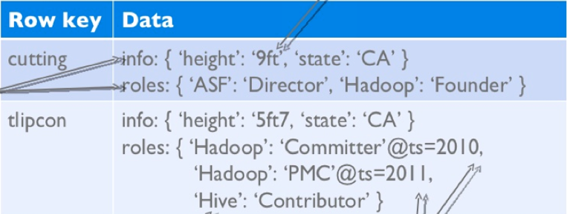
Notes on Data Model
HBase schema consists of several Tables
Each table consists of a set of Column Families
Columns are not part of the schema
HBase has Dynamic Columns
Because column names are encoded inside the cells
Different cells can have different columns
“Roles” column family has different columns in different cells

Slide 15
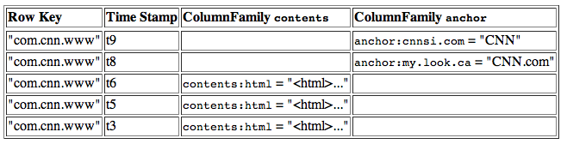
Notes on Data Model (Cont’d)
The version number can be user-supplied
Even does not have to be inserted in increasing order
Version number are unique within each key
Table can be very sparse
Many cells are empty
Keys are indexed as the primary key
Has two columns
[cnnsi.com & my.look.ca]

Slide 16
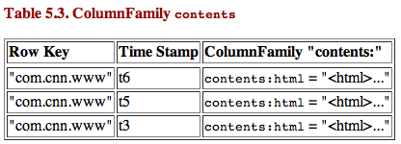
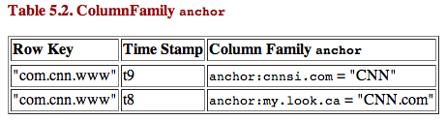
HBase Physical Model
Each column family is stored in a separate file (called HTables)
Key & Version numbers are replicated with each column family
Empty cells are not stored

Slide 17
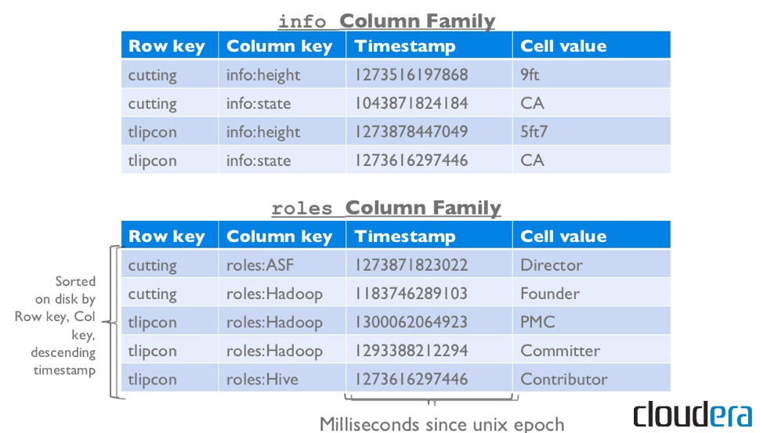
Example

Slide 18
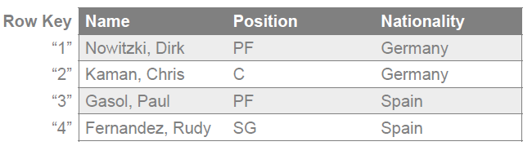
Need for Indexes
HBase has no built-in support for secondary indexes
API only exposes operations by row key
Find all players from Spain?
With built-in API, scan the entire table
Manually build a secondary index table
Exploit the fact that rows are sorted by row key based on byte order

Slide 19
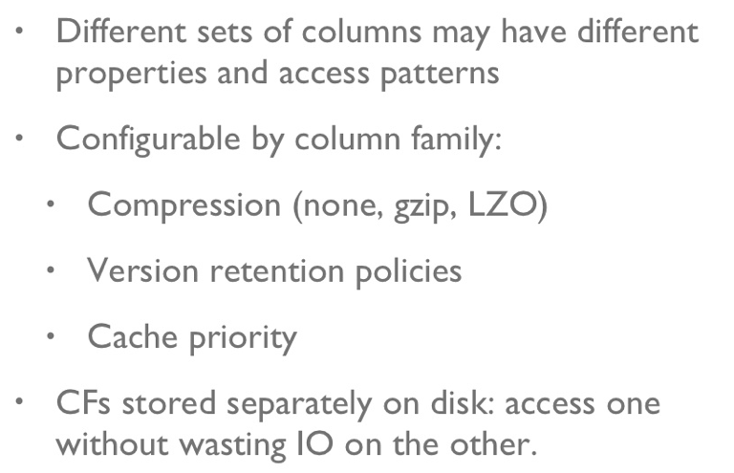
Column Families

Slide 20
HBase Regions
Each HTable (column family) is partitioned horizontally into regions
Regions are counterpart to HDFS blocks
Each will be one region

Slide 21
HBase Architecture

Slide 22
Three Major Components
The HBaseMaster
One master
The HRegionServer
Many region servers
The HBase client

Slide 23
HBase Components
RegionServer (many slaves)
Manages data regions
Serves data for reads and writes (using a log)
Master
Responsible for coordinating the slaves
Assigns regions, detects failures
Admin functions

Slide 24
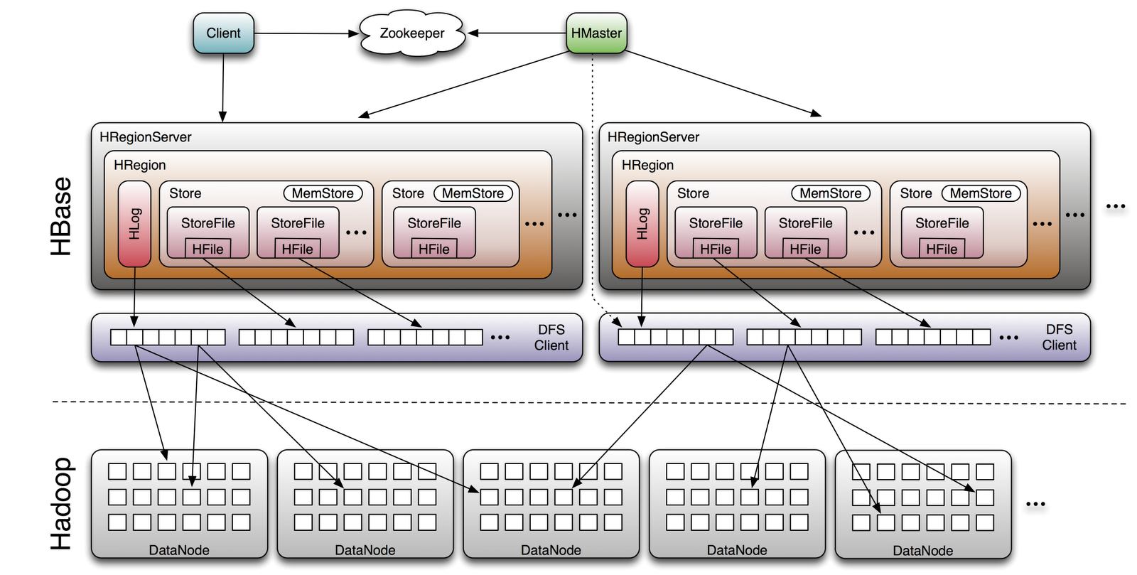
Big Picture

Slide 25
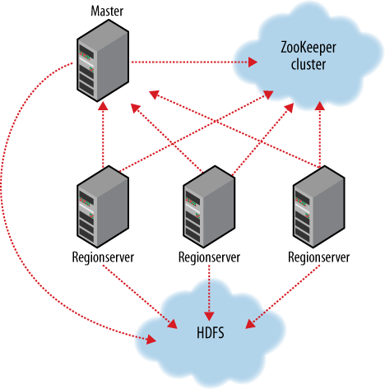
ZooKeeper
HBase depends on ZooKeeper
By default HBase manages the ZooKeeper instance
E.g., starts and stops ZooKeeper
HMaster and HRegionServers register themselves with ZooKeeper

Slide 26
Test Drive
See http://hbase.apache.org for full documentation
HBase Installation on Windows 10
https://www.solutionmandi.com/2018/11/hbase-installation-on-windows-10.html
To start HBase shell
% hbase shell
To see running processes
% jps
In standalone all daemons runs within Hmaster (Hmaster, RegionServer, ZooKeeper)
Hbase Web UI
http://localhost:16010
To connect to HBase
% hbase shell

Slide 27
Test Drive
To get help
hbase(main):001:0> help
To create a table named test with a single column family named data
hbase(main):002:0> create 'test', 'data'
To see list of created tables
hbase(main):003:0> list
To remove the table, you must first disable it before dropping it:
hbase(main):004:0> disable 'test'
hbase(main):005:0> drop 'test‘
To get description of your table
hbase(main):005:0> describe 'test‘

Slide 28
put, get, scan
To insert data into three different rows and columns in the data column family:
hbase(main):006:0> put 'test', 'row1', 'data:1', 'value1'
hbase(main):007:0> put 'test', 'row2', 'data:2', 'value2'
hbase(main):008:0> put 'test', 'row3', 'data:3', 'value3‘
To get the first row:
hbase(main):009:0> get 'test', 'row1‘
To list the table content:
hbase(main):010:0> scan 'test‘
To exit the shell
hbase(main):011:0> quit

Slide 29
Importing Data to HBase
Using ImportTsv to load txt to Hbase (from HDFS)
> Hbase org.apache.hadoop.hbase.mapreduce.ImportTsv
-Dimporttsv.separator=”,”
-Dimporttsv.columns=HBASE_ROW_KEY,cf hbase-tbl-01 /user/hadoop/tbl1_data.txt
From SQL Server to HBase using Sqoop (need SQL Server JDBC driver)
> sqoop import --hbase-create-table --hbase-table HBase_table --column-family cf1 --hbase-row-key id --connect "jdbc:sqlserver://hostname:port;database=dbName;username=uname;password=pass" --table sql_tablename -m 1

Slide 30
Apache HBase API
Java API
External API
REST
Thrift
C/C++
JDO
Scala
Jython
SPARK Support
HBaseContext
SparkSteaming
BulkLoad
SparkSQL/DataFrames

Slide 31
HBase Vs RDBMS
 | RDBMS | HBase
Data Layout | Row oriented | Column oriented
Query Language | SQL | get/put/scan/…etc
Indexes | On Arbitrary Column | Row key only
Max Data size | TBs | ~1PB
Read/write throughput limits | 1000s queries/sec | Millions queries/sec
Design Approach | Data Oriented (What data to store) | Reports Oriented (What data to show)

Slide 32
Example Twitter relationships (users following other users)
Read access pattern:
Who does a user follow?
Does a particular user A follow user B?
Who follows a particular user A?
Write access pattern:
User follows a new user.
User unfollows someone they were following.

Slide 33
Answer the questions:
Who does a user follow?
Does a particular user A follow user B?
Who follows a particular user A?
How to add users?
Need a counter

Slide 34
Unfollowing users is a problem.

Slide 35
The relationship table with the cells now having the followed user’s username as the column qualifier and an arbitrary string as the cell value.
Who follows a particular user A?

Slide 37
Read access pattern:
Who does a user follow?
Does a particular user A follow user B?
Who follows a particular user A?
Write access pattern:
User follows a new user.
User unfollows someone they were following.

Slide 38
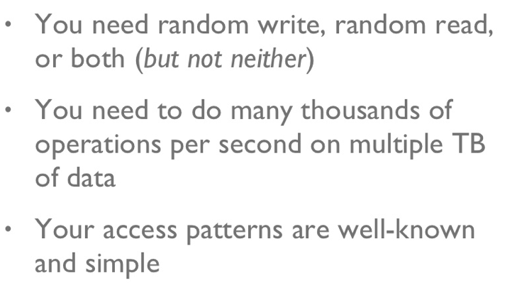
When to use HBase

